Slide 1
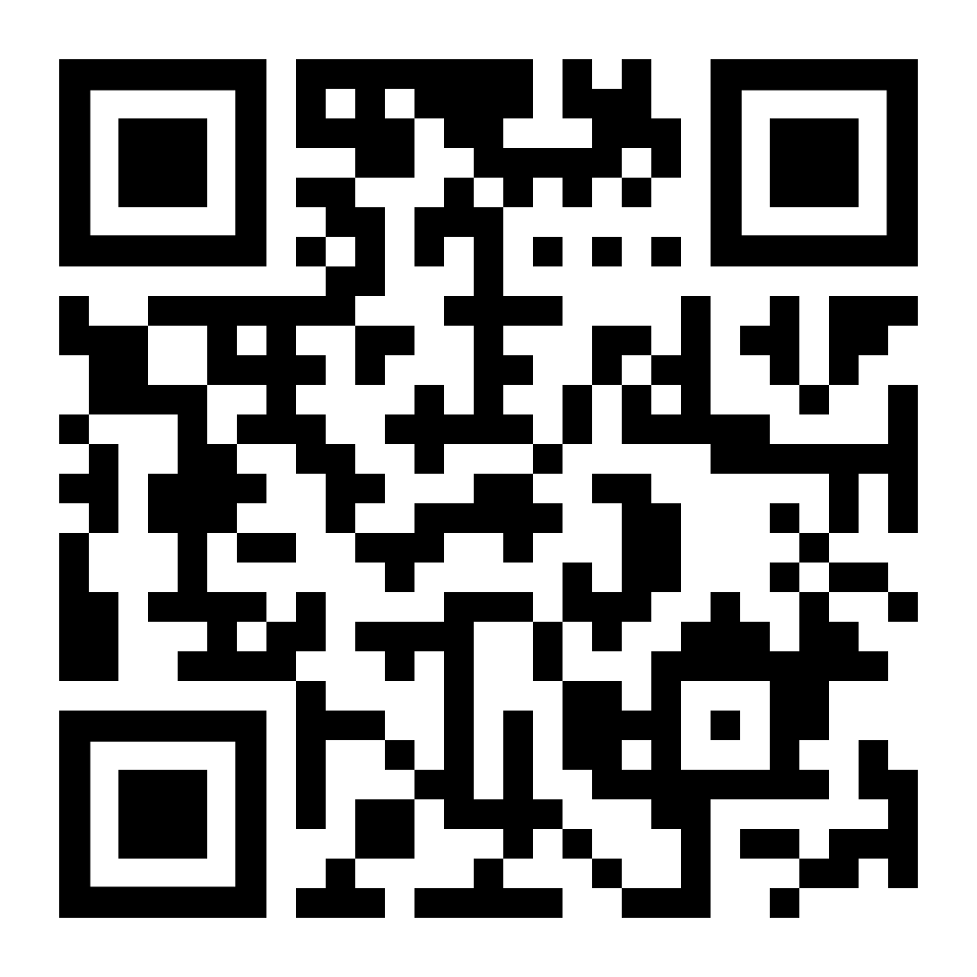
-WE KNOW YOUR AGE-
Group 4
Ray Jin
Sujith Xavier Kurian
Joshua Zhang

Slide 2
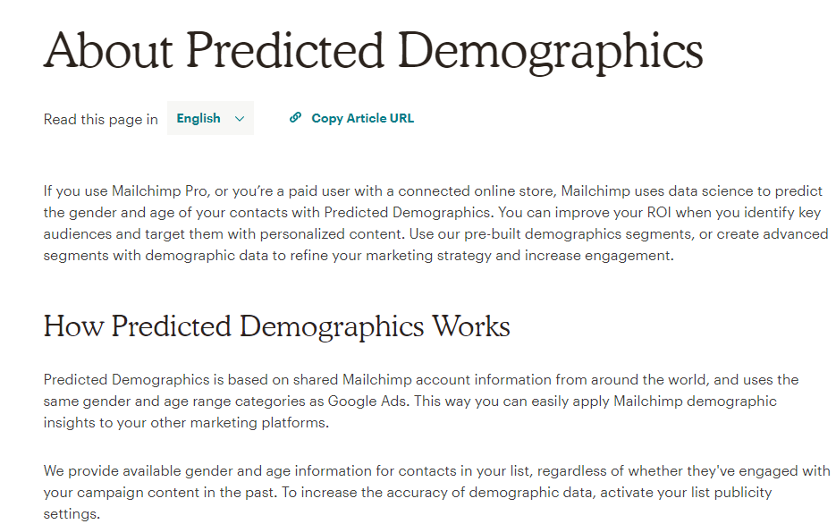
Hook
Are you passionate about animals?
Age prediction to identify target customers for marketing campaign
Age prediction based on various survey questions

Slide 3








Data Explanation
19
12
10
57
Total Participants
1010
people
Survey Questions
150
items
3
7
10
32
Notes:
1. Participants (1010 rows) :
2. Survey Questions(150 items columns):
Music preferences (19 items)
Movie preferences (12 items)
Hobbies & interests (32 items)
Phobias (10 items)
Health habits (3 items)
Personality traits, views on life, & opinions (57 items)
Spending habits (7 items)
Demographics (10 items)

Slide 4
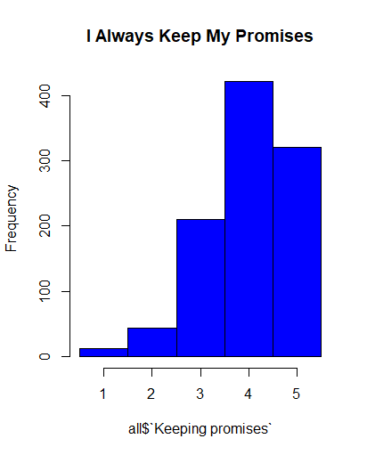
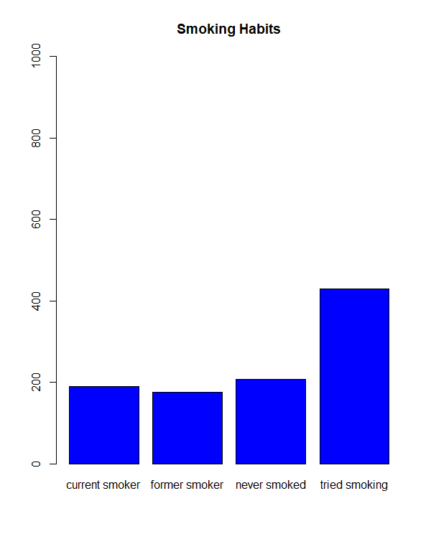
Quantitative & Categorical Variables
Strongly Disagree 1-2-3-4-5 Strong Agree
Categorical
Notes:
Survey Questions(139):
I always keep my promises.:
Strongly disagree 1-2-3-4-5 Strongly agree (integer)
Categorical Questions(11):
Smoking Habits
Never smoked - Tried smoking - Former smoker - Current smoker (categorical)

Slide 5
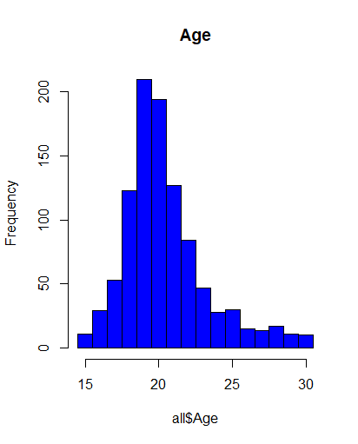
Variable Definition
We will try to predict Age, using all the other variables and data in the dataset.
We will use the column names as variable names instead of x₁,x₂ etc..
Notes:
Y: Age(in demographics category)
Xs: all other 149 survey questions
Music preferences, Movie preferences, Hobbies, etc.
Intuition:
Identify correlation between Age and all other survey questions
Build regression models to predict age

Slide 6
Industry Knowledge Emulation

Slide 7

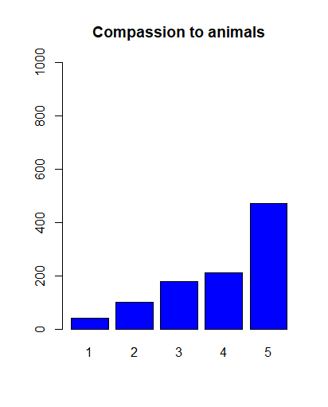
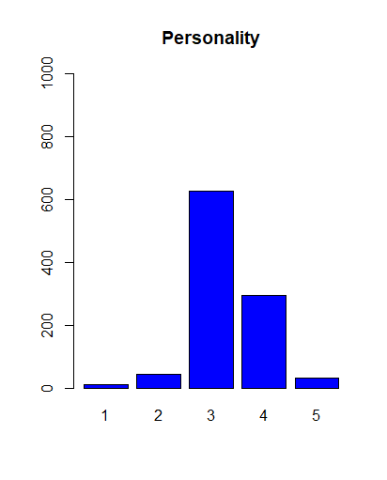
Industry Knowledge Emulation Model (IKEM)
More than 60%
VS.
Less than 20%
Notes:
The interpretation of the distribution of any particular question is:
Large percentage of responses = “3” means overall weak opinion of the question
Only include survey questions that have less than 20% of the responders choose “3”.
A survey question’s distribution with higher variance would be indicative of clusters of responders of similar age.
Use these variables, along with all qualitative and quantitative survey questions to predict Age via regression.

Slide 8
IKEM Justification
Motivation: Reduce number of low quality variables
Result: Variable count reduced from 149 to 44
Note: Variables maintained after filter only applies in context of the whole survey. Cannot compare a survey with only these questions to the full survey.
Example: You may have answered “3” for Personality because the previous question on the survey asked if you consider yourself a judgmental person. Your answer for personality is reasonably affected by the previous question.

Slide 9
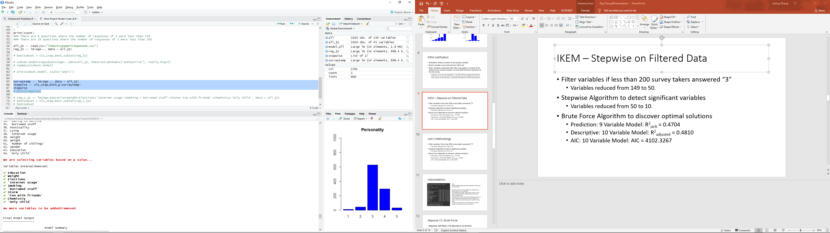
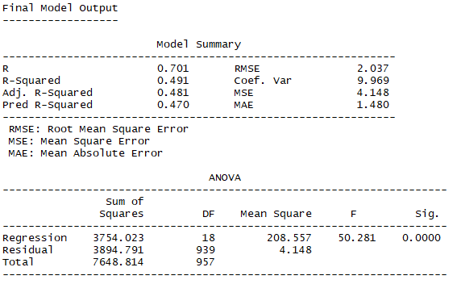
IKEM – Stepwise on Filtered Data
R² = 0.491, Adj. R² = 0.481, Pred R² = 0.470

Slide 10
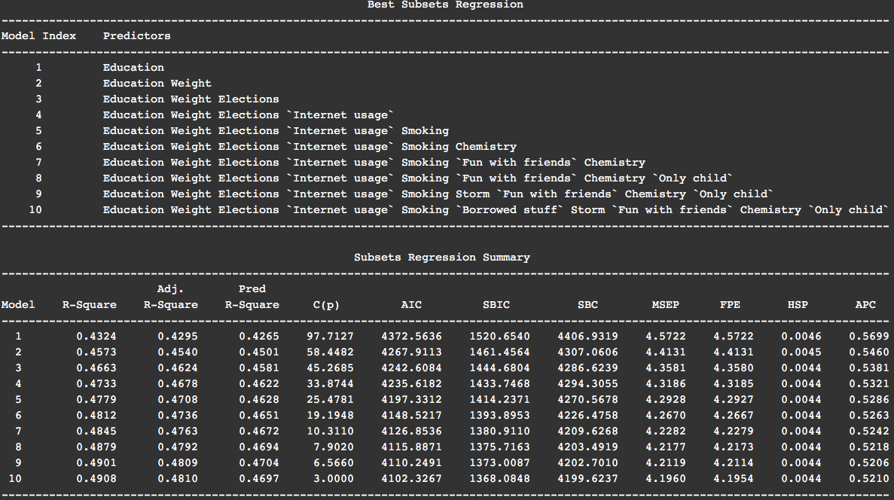
10 Variables? Brute Force it!

Slide 11
What did we just see?
Adjusted R² and AIC suggested that the ten variable model gives the best performance.
For describing the dataset, we should use the model with 10 variables. In fact, we will see that there’s a lot of room to grow!
Prediction R2 suggested that the nine variable model outperforms the ten variable model.
Well that’s interesting. Since we’re trying to PREDICT your age, I suppose we should use this model!

Slide 12
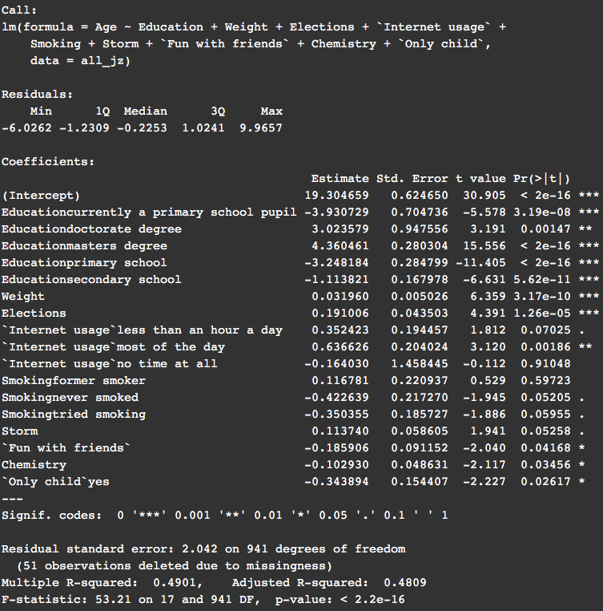
Interpretations
Note:
Unless detailed below, all beta coefficients are logical by common sense.
Education seems to be very significant in determining a person’s age. This is expected.
The coefficient for weight suggests that someone 1 year older will weigh 1/0.032 = 31.25 pounds more, which seems a little bit high.
A phobia of storms (Storm) increases with age. On the one hand, children may be scared of a storm’s ferocity, but storms could cause property damage for people who are older.
Socializing is more important for younger people. This seems appropriate and logical.

Slide 13
IKEM vs Professor Bhaduri
Did our beloved Professor’s lessons help us perform better?

Slide 14
Stepwise V.S. Brute Force
Stepwise: (149*150)/2= 11175 Seconds or 186.25 Mins
(My Mac → under 3 mins)
Brute Force: 2¹⁵⁰ = 7.1362385e+44
Take forever to finish

Slide 15
Stepwise Selection(Level 1,2)
Level 1: Included all variables, linear regression model
R²= 0.6478 R²_{a}=0.544 PRESS =3152.945 R²_{jack} = 0.3727
(Base Model, improve upon)
Level 2: Stepwise selection(38 variables selected)
R²= 0.585 R²_{a}=0.561 PRESS =3139.057 R²_{jack} = 0.4604

Slide 16
Stepwise Selection(Level 3)
Level 3: Excluded insignificant & unrelated variables(8)
& Combined Terms(2)
R²= 0.598 R²_{a}=0.5765 PRESS =3063.743 R²_{jack} = 0.5507
Terms deleted for Level 3:
Branded clothing high p value →0.086
Cheating in school high p value →0.144
Is only child → irrelevant
block of flat VS bungalow → irrelevant
Term modified for Level 3
internet usage & smoking

Slide 17
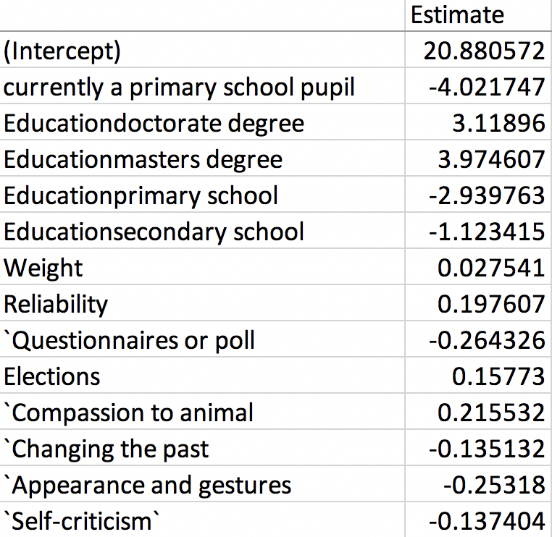
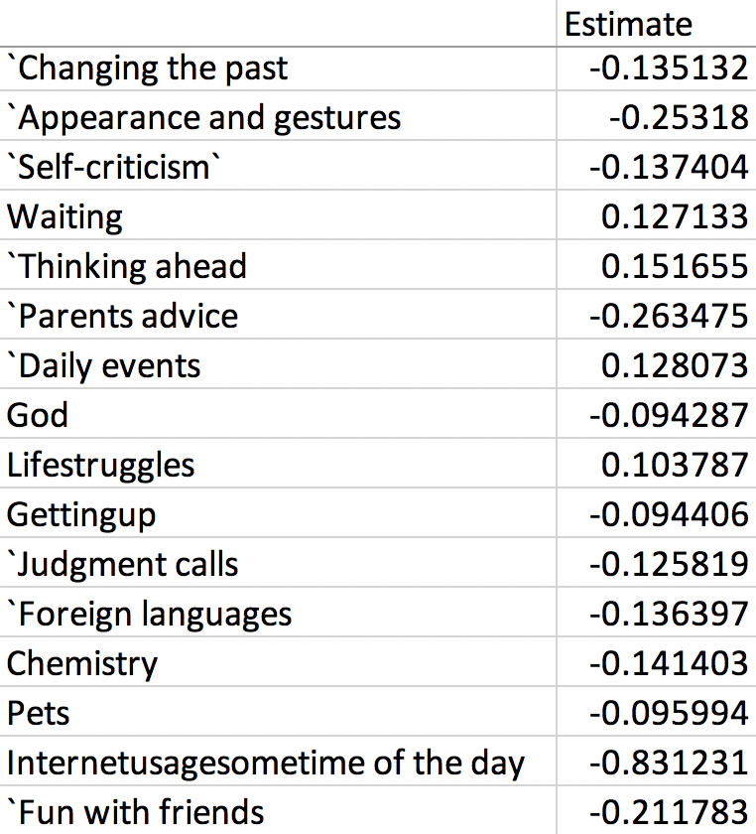
Interpretations

Slide 18
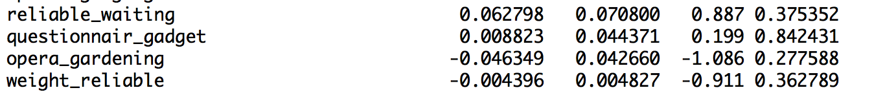
Stepwise Selection(Level 4)
Level 4: Add Interaction Terms
R²=0.599 R²_{a}=0.5760 PRESS =3085.696 R²_{jack} = 0.4525
reliable_waiting=reliable * waiting
questionnair_gadget=questionnair*gadgets
opera_gardening=opera*gardening
weight_reliable=weight * reliable

Slide 19
Final Model: Level 3
Level 1: R²= 0.6478 R²_{a}=0.544 PRESS =3152.945 R²_{jack} = 0.3727
Level 2: R²= 0.585 R²_{a}=0.561 PRESS =3139.057 R²_{jack} = 0.4604
Level 3: R²= 0.598 R²_{a}=0.5765 PRESS =3063.743 R²_{jack} = 0.5507
Level 4: R²=0.599 R²_{a}=0.5760 PRESS =3085.696 R²_{jack} = 0.4525
IKEM: R² = 0.491 R²_{a} = 0.481 R²_{jack} = 0.470

Slide 20
Conclusions and Future Work
With the goal of predicting the age and a large number of cause variables to analyze we used a combination of Brute Force and Step Wise method to identify and compare the outcomes of significant variables through Adj R², p-value and R²_{jack} .
Challenge: Brute force method involving large number of variables requires lot more computer memory.
The statistical data that was analyzed is from users in Bratislava and so the prediction may not work as expected for users in other countries with a different socio-economic culture / lifestyle. However the significant variables identified through this project will help / guide with data collection in other countries.

Slide 21
Acknowledgement
Data provided by Miroslav Sabo: https://www.kaggle.com/miroslavsabo/young-people-survey
The data contains a few missing values.
All participants were of Slovakian nationality.
Ages are between 15-30.

Slide 22
Q&A
Any Questions?

